Slide 1
Table of Shewbread
”You prepare a table in the wilderness”

Slide 2
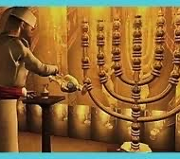
Lampstand
7 branches
Only Source of light
Caption

Slide 3
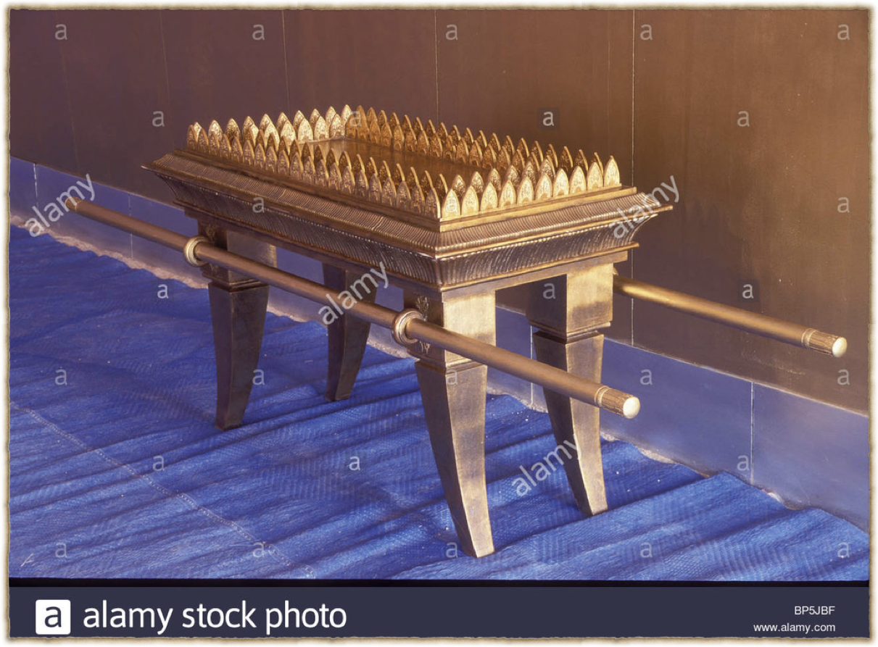

Slide 4
“The Bread of His Face”

